Slide 1

The Cloud We Share: Access control on Symmetrically Encrypted Data in Untrusted Clouds
by
G. Ajay Kishore
Roll No. 204G1A0506
M. Mounika
Roll No. 204G1A0561
T. Harsha Sri
Roll No. 204G1A0536
B. Bhavana
Roll No. 204G1A0522
Under the guidance of
Mr. M. Narasimhulu M.Tech (Ph.D)
Assistant Professor
Department of Computer Science and Engineering
Srinivasa Ramanujan Institute of Technology
(Autonomous)
2023 - 2024

Slide 2

Contents
Abstract
Problem statement
Objectives of Project
Literature survey for first objective
Literature survey for second objective
Proposed Work
References
GitHub Link
Queries

Slide 3
Abstract
In Today's world, Along with the rapid growth of cloud environments, rises the problem of secure data storage – a problem that both businesses and end-users take into consideration before moving their data online.
In the System, we are using cryptography techniques. The data can be stored as cipher text. In the encryption, all the files are encrypted using master public key so that the resulted ciphertext is bound by a policy. Moreover, each user has a unique secret key associated with the user’s attributes. Thus, decrypting a file is possible if and only if the user’s attributes satisfy the policy bound to the ciphertext.
Keywords: Encryption, Ciphertext, Cryptography.

Slide 4
Problem Statement
The increase in data breaches in cloud computing puts all users at risk of
business problems, highlighting the need to improve security measures.
To mitigate the growing risks of data threats faced by users in cloud
Environment, proactive measures are essential.

Slide 5
Objectives of Project
To implement both the cryptographic techniques need to be adapted to cloud- based environments to create a hybrid encryption scheme.
Enhancing security before moving data online using hybrid cryptographic technique and addressing the problem of revocation.

Slide 6
Literature survey for First objective
[1] In this paper, The proposed system says that the categorized searchable encryption algorithm develops the different structures that are deployed on which security and efficiency rely. By using this algorithm, we will be encrypting the particular block of Data so that only particular data will be encrypted instead of whole data. Furthermore, hybrid approaches using a combination of primitives can provide more properties securely.

Slide 7
Literature survey for Second objective
[2] In this paper, the system says that In several distributed systems a user should only be able to access data if a user posses a certain set of credentials or attributes. Currently, the only method for enforcing such policies is to employ a trusted server to store the data and mediate access control. However, if any server storing the data is compromised, then the confidentiality of the data will be compromised. In this paper we present a system for realizing complex access control on encrypted data that we call ciphertext-policy attribute-based encryption.

Slide 8
Proposed System
In proposed system, we use these two cryptographic techniques that squarely fit cloud-based environments to design a hybrid encryption scheme based on ABE and SSE in such a way that we utilize the best out of both of them.
The data can be encrypted into cipher text before moving into cloud by using a single key.
The revocation mechanism and an access control one, that are agnostic to the cryptographic primitives used in our construction.

Slide 9
References
[1] Geong Sen Poh, Ji-Jian Chin, Wei-Chuen Yau, Kim-Kwang Raymond Choo, and Moesfa Soeheila Mohamad. 2017. “Searchable symmetric encryption: Designs and challenges”. ACM Comput. Surv. 50, 3, Article 40 (May 2017)
[2] J. Bethencourt, A. Sahai, and B. Waters, ‘‘Ciphertext-policy attribute-based encryption,’’ in Proc. IEEE Symp. Secur. Privacy (SP). Washington, DC, USA: IEEE Computer Society, 2007, pp. 321–334.
[3] A.Bakas and A. Michalas, “The Cloud we Share: Access Control on Symmetrically Encrypted Data in Untrusted Clouds” IEEE Access(Volume 8), 2020.

Slide 10
References
[4] A. Boldyreva, V. Goyal, and V. Kumar, ‘‘Identity-based encryption with efficient revocation,’’ in Proc. 15th ACM Conf. Comput. Commun. Secur. (CCS), New York, NY, USA, 2008, pp. 417–426.
[5] J. Bethencourt, A. Sahai, and B. Waters, ‘‘Ciphertext-policy attribute-based encryption,’’ in Proc. IEEE Symp. Secur. Privacy (SP). Washington, DC, USA: IEEE Computer Society, 2007, pp. 321–334.

Slide 11
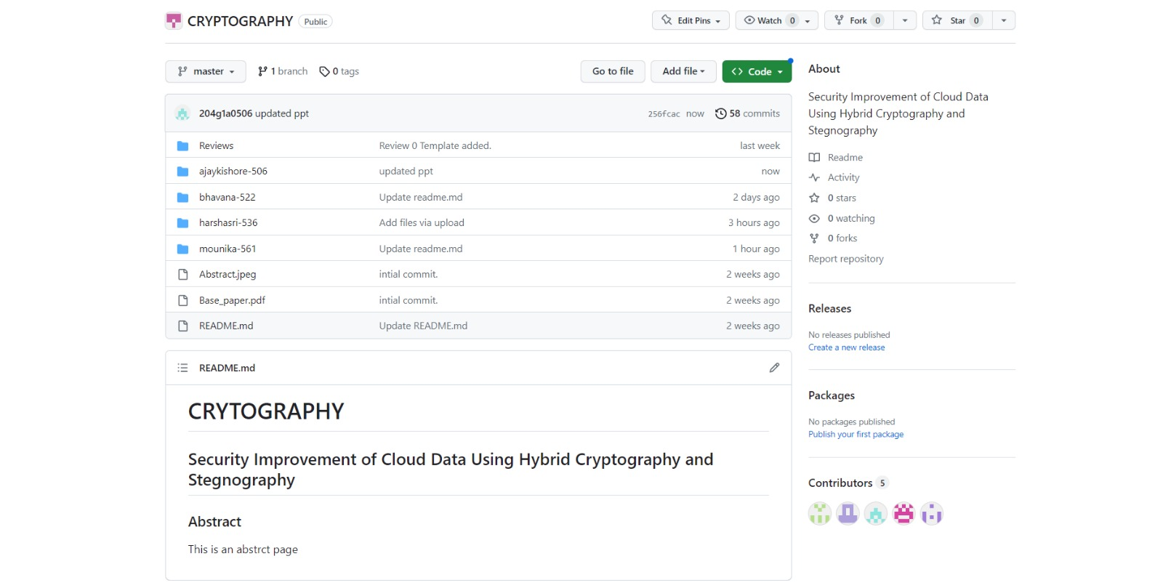
Git Hub Dashboards of each student
https://github.com/SRIT-CSE/CRYPTOGRAPHY.git

Slide 12
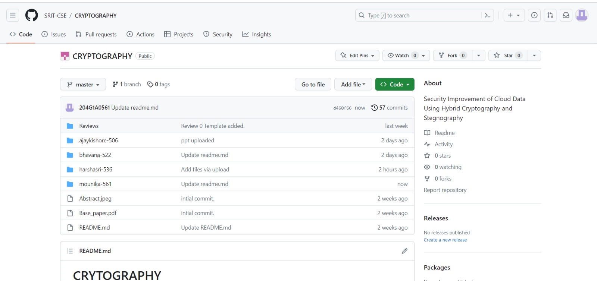
Git Hub Dashboards of each student
https://github.com/SRIT-CSE/CRYPTOGRAPHY.git

Slide 13
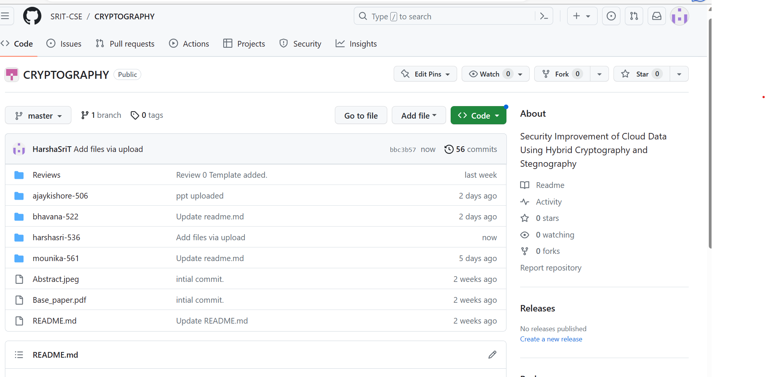
Git Hub Dashboards of each student
https://github.com/SRIT-CSE/CRYPTOGRAPHY.git

Slide 14
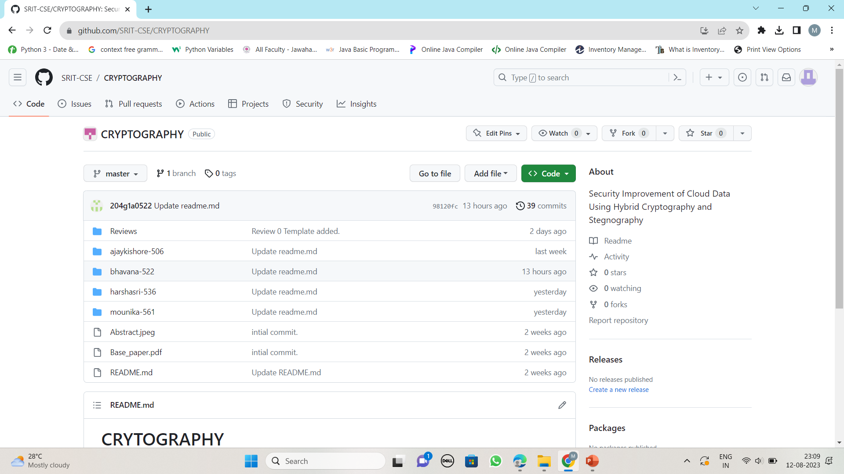
Git Hub Dashboards of each student
https://github.com/SRIT-CSE/CRYPTOGRAPHY.git

Slide 15
Any Queries?

